Slide 1

UEE2601
Microprocessor & Microcontrollers and its Practices
Project: Temperature and Humidity Monitoring and Control System with Data Logging
Team members
​
-Keerthi Sheevani G - 3122233001052
-Krithika S - 3122233001055
-Nidhi Krishna D - 3122233001064
1

Slide 2
Problem Statement
Environmental parameters like temperature and humidity are critical in many applications such as battery systems, agriculture, storage, and industries.
Existing basic systems only display data and lack:
  Real-time alerts
  Automatic control
  Data logging for analysis
The objective of the project is to design a system that measures temperature and humidity using sensors to implement for trend analysis.
2

Slide 3
System Methodology
Data Acquisition
  DHT11 sensor measures temperature & humidity
Data Processing
  Reads sensor data
  Converts into digital values
Display
  Real-time values shown on LCD
Data Logging
  Sensor data stored in SD card (CSV format)
Continuous Monitoring
  Process repeats at fixed intervals
3

Slide 4
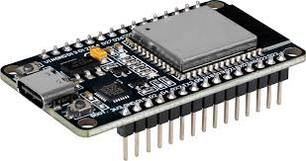
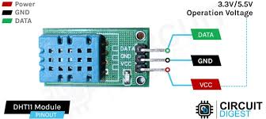
Key Components-Hardware Components
ESP32 Microcontroller (ESP32-WROOM-32)
Dual-core processor (up to 240 MHz)
Built-in WiFi and Bluetooth
Handles sensor reading, control
& data logging
Interfacing
Uses GPIO pins for sensor input (DHT11)
Uses SPI protocol for SD card (optional local logging)
Uses I2C / digital pins for LCD display .
DHT11 Sensor
Measures temperature and humidity
Interfacing:
  VCC → 3.3V / 5V
  GND → GND
  DATA → ESP32 GPIO (e.g., PA1)
4

Slide 5
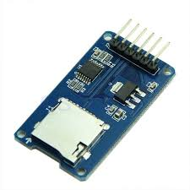
SD Card Module​
Stores data in CSV format ​
Uses SPI communication ​
​SPI (Serial Peripheral Interface) is a synchronous communication protocol used to transfer data between a master and slave devices (SD card, sensors, etc.)
\
Used for high-speed data transfer between microcontroller and peripherals
ESP32 acts as Master, SD card acts as Slave
MOSI (Master Out Slave In): Data from ESP32 → device
MISO (Master In Slave Out): Data from device → ESP32
SCK (Serial Clock): Synchronizes data transfer
CS (Chip Select): Selects the slave device
Working Principle​
ESP32 selects device by making CSLOW ​
Clock signal (SCK) is generated ​
Data is transferred bit-by-bit: ​
  Sent via MOSI ​
  Received via MISO ​
Communication ends when CS goesHIGH ​
.​
5

Slide 6
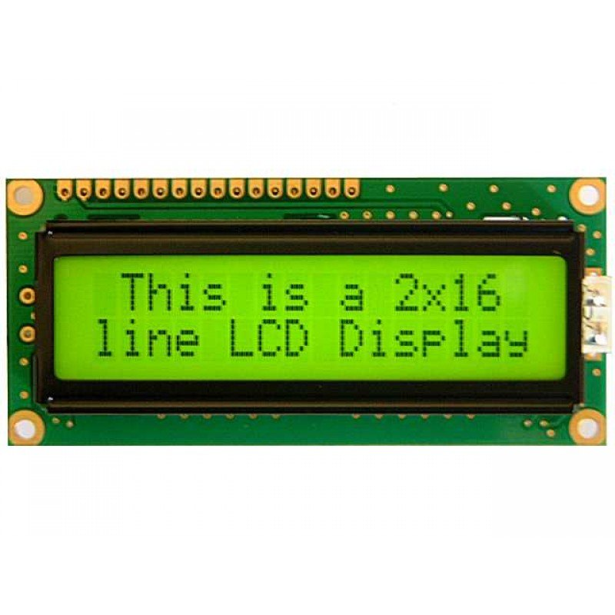
LCD Display (16x2)​
Displays real-time readings
Uses I2C communication
I2C (Inter-Integrated Circuit) is a 2-wire synchronous communication protocol used to connect multiple devices using only two lines.
I2C (Inter-Integrated Circuit) is a synchronous communication protocol
ESP32 acts as Master, devices like LCD act as Slave
I2C Signals
SDA (Serial Data Line): Transfers data
SCL (Serial Clock Line): Synchronizes communication
Working Principle
ESP32 sends a START condition
Sends address of the slave device
Slave responds with ACK (acknowledgement)
Data is transferred via SDA, controlled by SCL
Communication ends with a STOP condition
Key Features​
Uses only 2 wires (less wiring) ​
Supports multiple devices using addresses ​
Simple and efficient communication ​
Slower compared to SPI
5

Slide 7
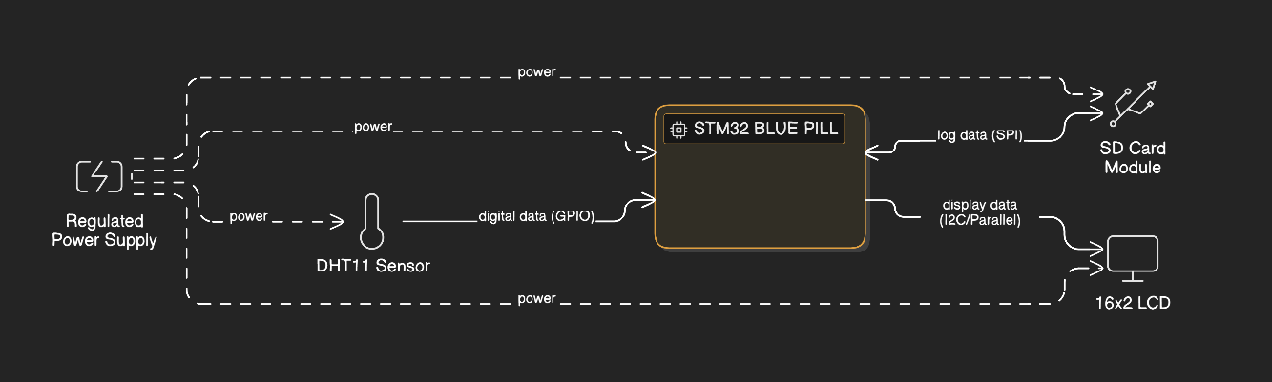
ARCHITECTURE
ESP32
The system is powered by a regulated power supply that provides stable voltage to all components. The DHT11 sensor measures temperature and humidity and sends the data to the ESP32 through a GPIO pin. The ESP32 processes this data and performs two main operations: displaying the real-time values on a 16x2 LCD and storing the data in an SD card using SPI communication. The system continuously monitors environmental conditions and logs the data for future analysis.
6

Slide 8
DATA ACQUISITION
The DHT11 sensor is used to measure:
  Temperature (°C) ,Humidity (%)
It senses environmental conditions and converts them into digital signals
The sensor communicates with the ESP32 using a single-wire digital protocol
The ESP32 sends a start signal, and the DHT11 responds by transmitting data in a timed digital format
Data Format
Total data = 40 bits
  8 bits → Humidity (integer)
  8 bits → Humidity (decimal)
  8 bits → Temperature (integer)
  8 bits → Temperature (decimal)
  8 bits → Checksum
  Acquisition Cycle
Data is read at regular intervals .
7

Slide 9
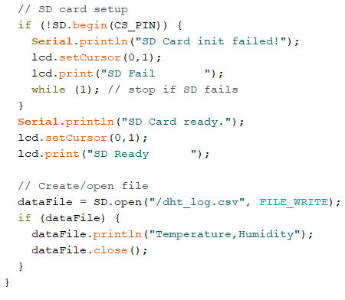
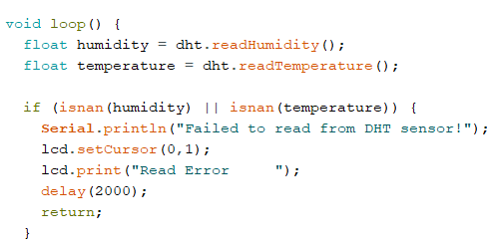
SAMPLE CODE SNIPPETS
Software Used:Arduino IDE
8

Slide 10
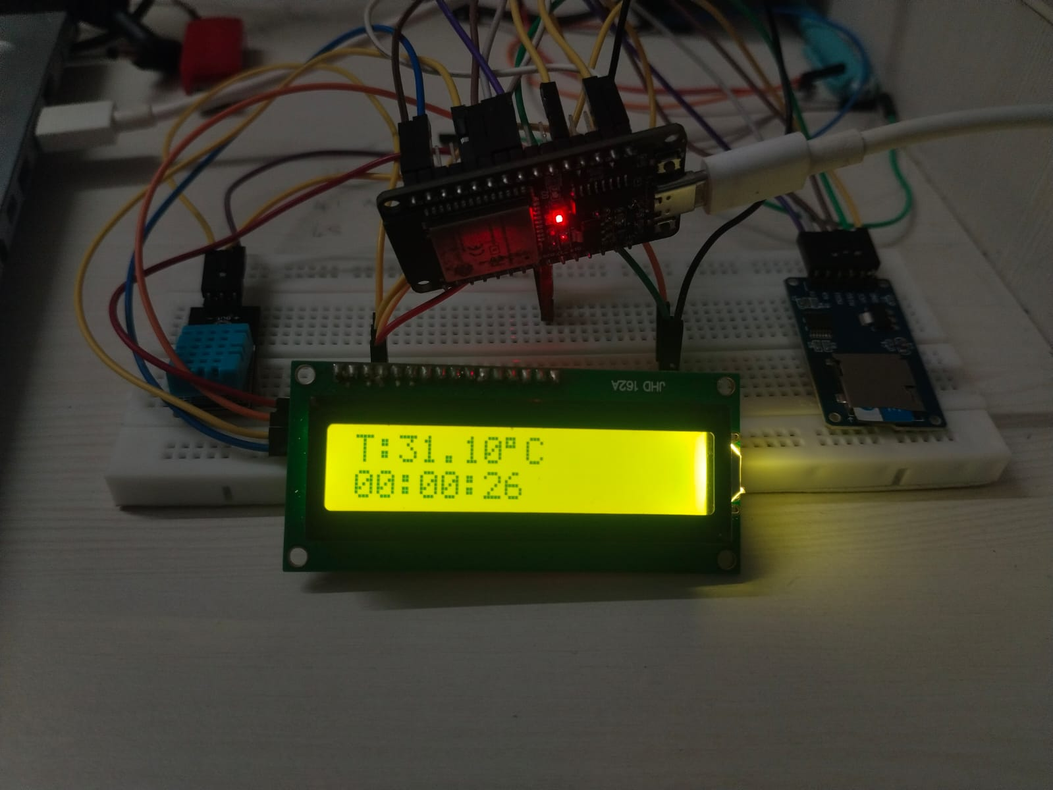
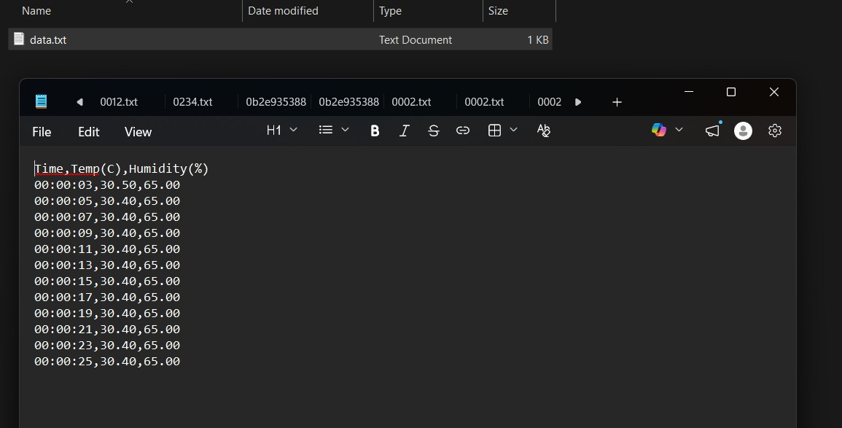
RESULT
9

Slide 11
OUTCOME
System measured and displayed:
  Temperature
  Humidity
Data was accurately stored in SD card
FEATURES AND APPLICATIONS
Modular and scalable system design
Combines monitoring + data logging
Enables data-based analysis (trend tracking)
Easily extendable with additional sensors/IoT
It can be used in different fields such as industrial monitoring,batteryhealth monitoring and storage systems
10

